Slide 1
Vidya Poshak - Dharwad 20-July-2024 Presented by Vinayak Goni

Slide 2
Table of contents (TOC) 1. Ice breaker 2. How much negativity do we possess? 3. Story of a Bumble bee 4. Soft skills 4. All that matters is attitude 5. Building Resume 6. Facing the interview(s) 7. References

Slide 3
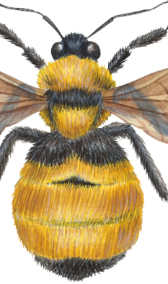
Bumble bee

Slide 4


Slide 5
Soft skills
What are Soft skills?
Importance of Soft Skill
Important Soft Skills?
Communication skills
Body language
Making Decisions
Self Motivation
Leadership Skills
Team-Working Skills
Creativity and Problem-Solving Skills
Time Management
Conclusion

Slide 6
What are Soft skills?
Soft skills is a synonym for "people skills." The term describes those personal attributes that indicate a high level of emotional intelligence.
Unlike hard skills, which describe a person's technical skill set and ability to perform specific tasks, soft skills are broadly applicable across job titles and industries.
It's often said that hard skills will get you an interview but you need soft skills to get -- and keep -- the job.

Slide 7
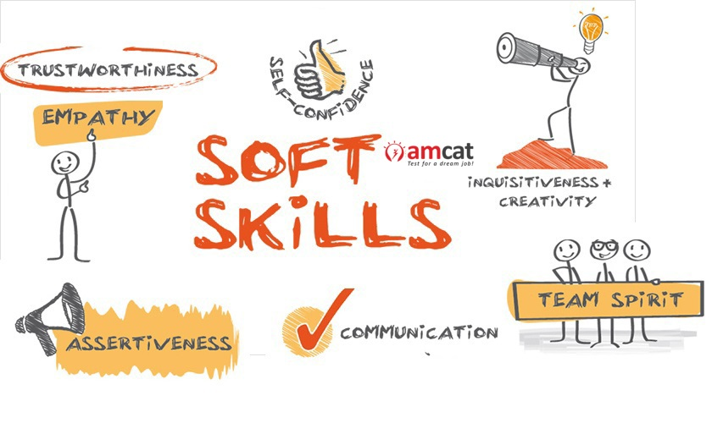
Importance of Soft Skill
To handle interpersonal relations
To take appropriate decisions
To communicate effectively
To have good impression and impact to gain professional development

Slide 8
What are the Most Important Soft Skills?
Communication skills
Body language
Making Decisions
Self Motivation
Leadership Skills
Team-Working Skills
Creativity and Problem-Solving Skills
Time Management and ability to work under Pressure

Slide 9

Communication skills
Communication skills are always top of the ‘essential skills’ list in any job advertisement.
People with strong communication skills can build relationships (from the initial building rapport through to a longer-term relationship), listen well, and vary their communication to suit the circumstances.

Slide 10
Activity on communication Drawing the Image

Slide 11

Making Decisions
Valued by employers for many reasons, being able to make decisions is key to getting on in life.
Sometimes the actual decision doesn’t even matter; what matters is that you have made one and moved on.
Example of James bond of india.
https://www.youtube.com/watch?v=1bDvw4UVmyA

Slide 12

Self Motivation
People who are self-motivated get on by themselves.
They don’t need close supervision and they are good to work with because they are generally positive about life and can be counted upon to keep going.
It also helps to work on your personal resilience and adaptability to change.

Slide 13

Body language
Face is the index of the mind and it clearly displays the persons interest
Body language presents to the audience what we feel & think about the particular matter
Ex: Nodding one’s head
Body language (e.g, arms crossed, standing, sitting, relaxed)
Emotion of the sender & receiver (e.g, speaking clearly, enthusiastic)

Slide 14
Activity 2 Video for activity

Slide 15

Leadership
Leadership is a soft skill you can show even if you’re not directly managing others.
Leadership can be thought of as a collection of various other soft skills, such as a general positive attitude and outlook, the ability to communicate effectively, and an aptitude for both self-motivating and motivating others.

Slide 16

Team-Work
Like leadership, good teamwork involves a combination of other soft skills.
Working in a team towards a common goal requires the intuition and interpersonal acumen to know when to be a leader, and when to be a listener.
Good team players are perceptive, as well as receptive to the needs and responsibilities of others.

Slide 17
Activity 3 Arrange the numbers

Slide 18
Creativity and Problem-solving
Creativity and problem-solving skills are highly valued because they are hard to develop.
There are many people who believe that creative thinkers are born, not made, and there are certainly some people who find these skills much easier.
But, like other skills, you can develop them if you work to do so and our pages on these topics will give you some ideas about how to do this.

Slide 19
Time Management and Ability to work under pressure
Many would say that these two skills, which often go hand-in-hand, are more an attitude than a skill.
However they can also be developed and honed, which is why we include them as skills.
Highly valued by employers, they are also very useful for organizing a family or a team, and for making sure that the job gets done.

Slide 20

Activity 4

Slide 21
Activity 5 Problem of a bullock cart

Slide 22
Story of a Man with only hand
https://www.youtube.com/watch?v=HnANWZHfykU

Slide 23
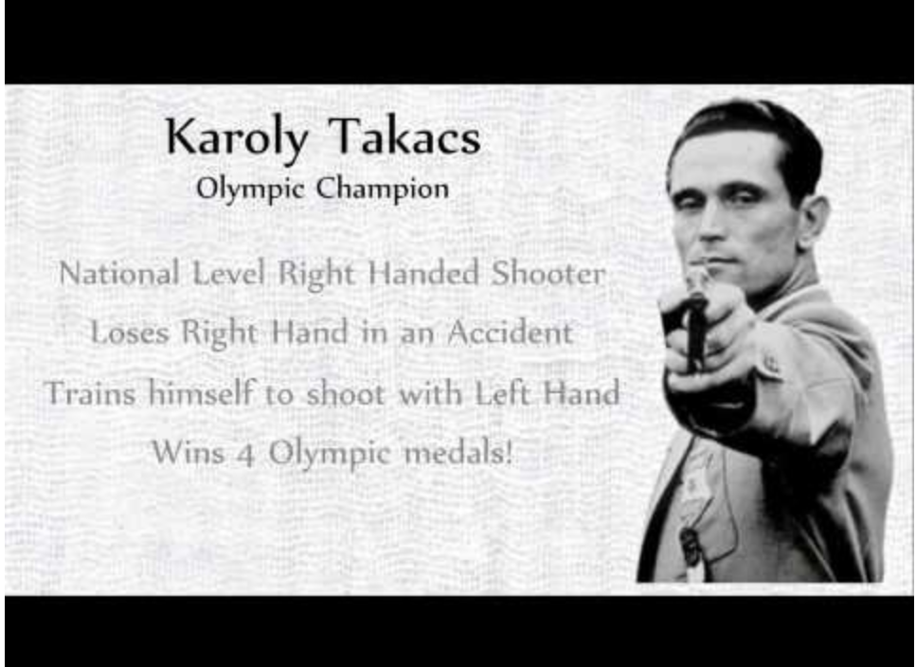

Slide 24
Conclusion
More and more businesses are considering soft skills as important job as an criteria.
An increase in service industry emphasizes the need for soft skills.
Soft skills are used in personal and personal life.

Slide 25


Slide 26
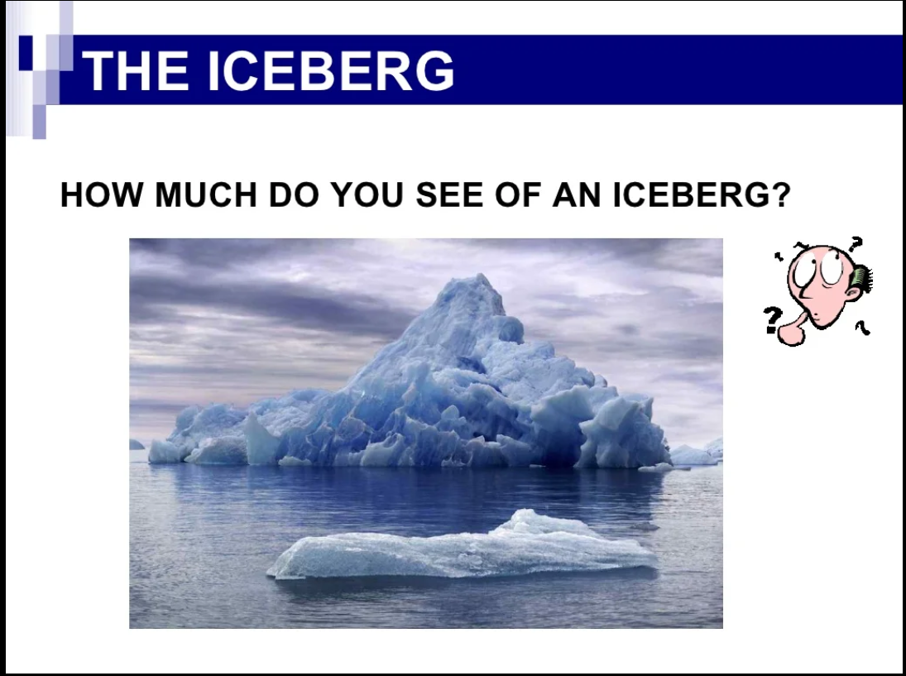

Slide 27
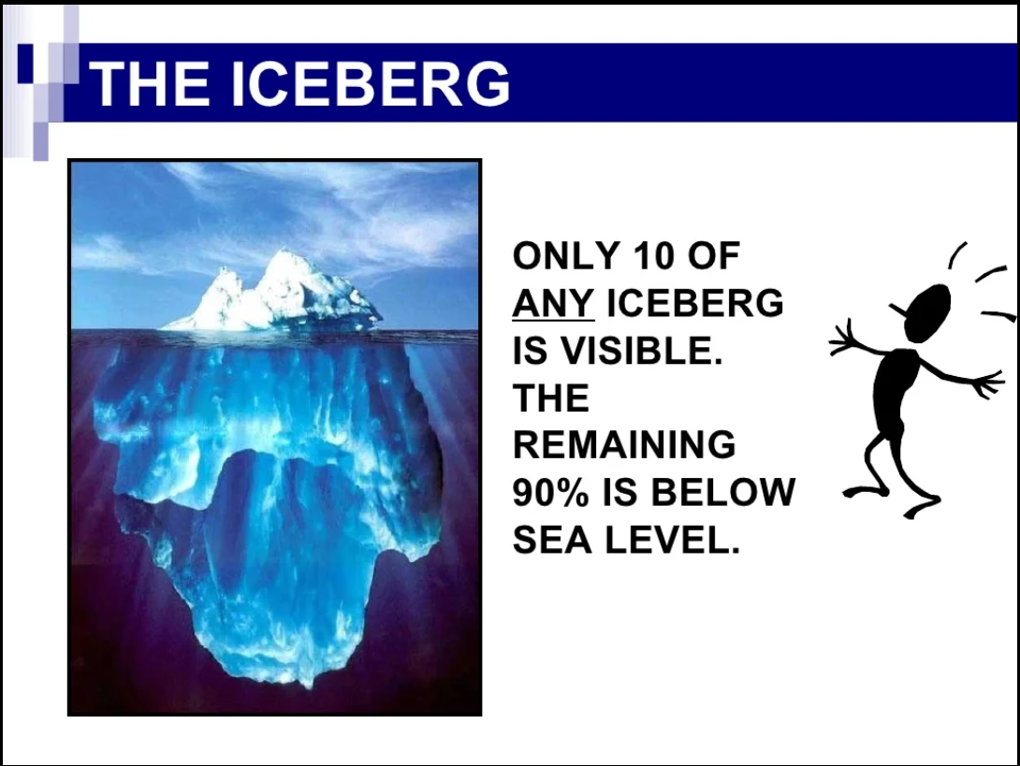

Slide 28
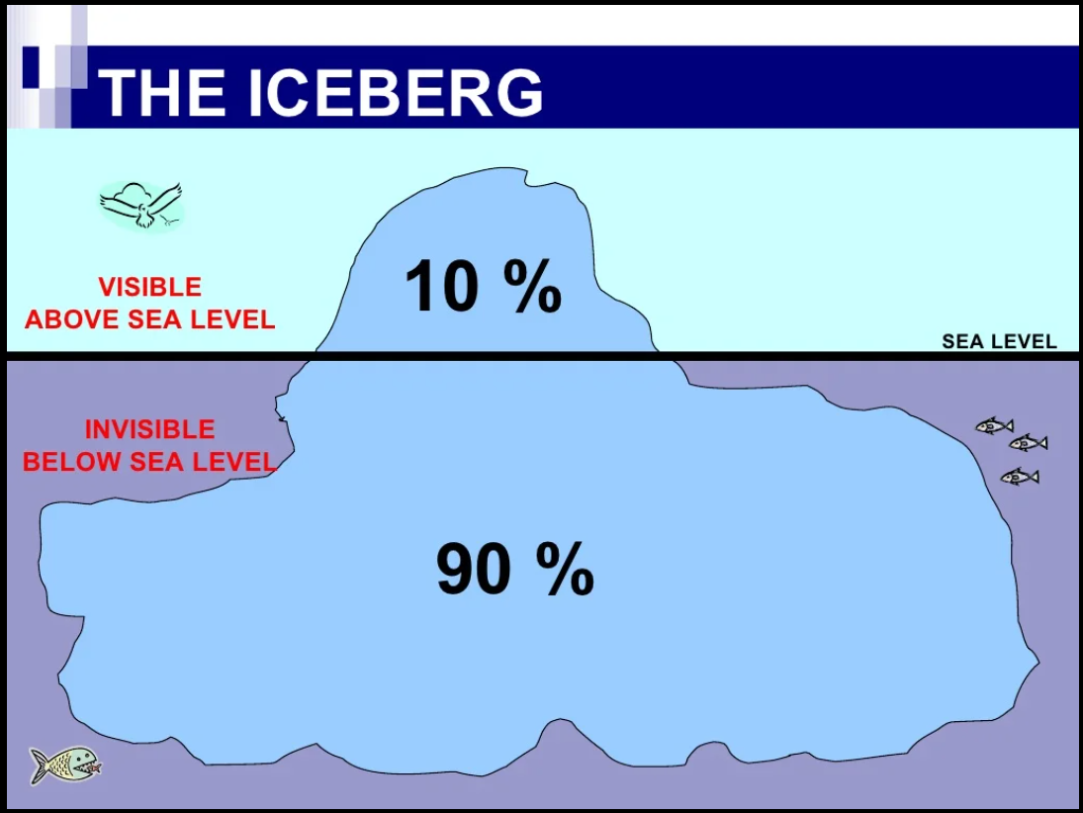

Slide 29
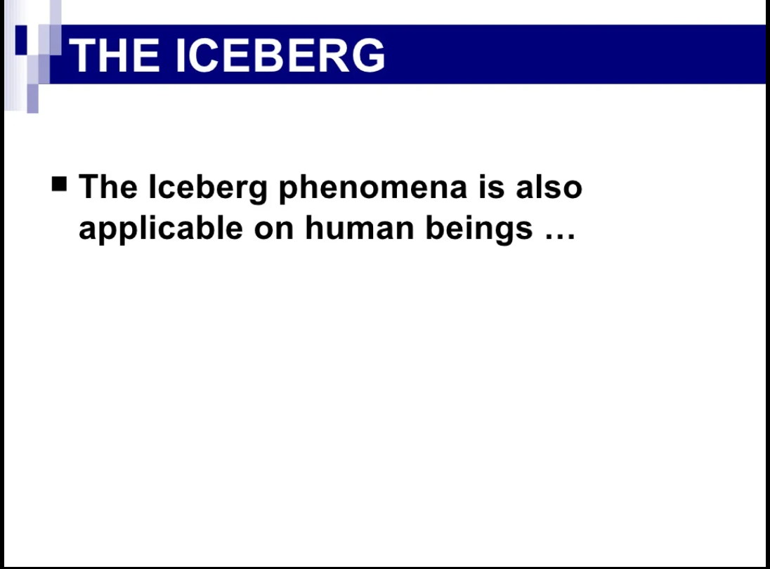

Slide 30
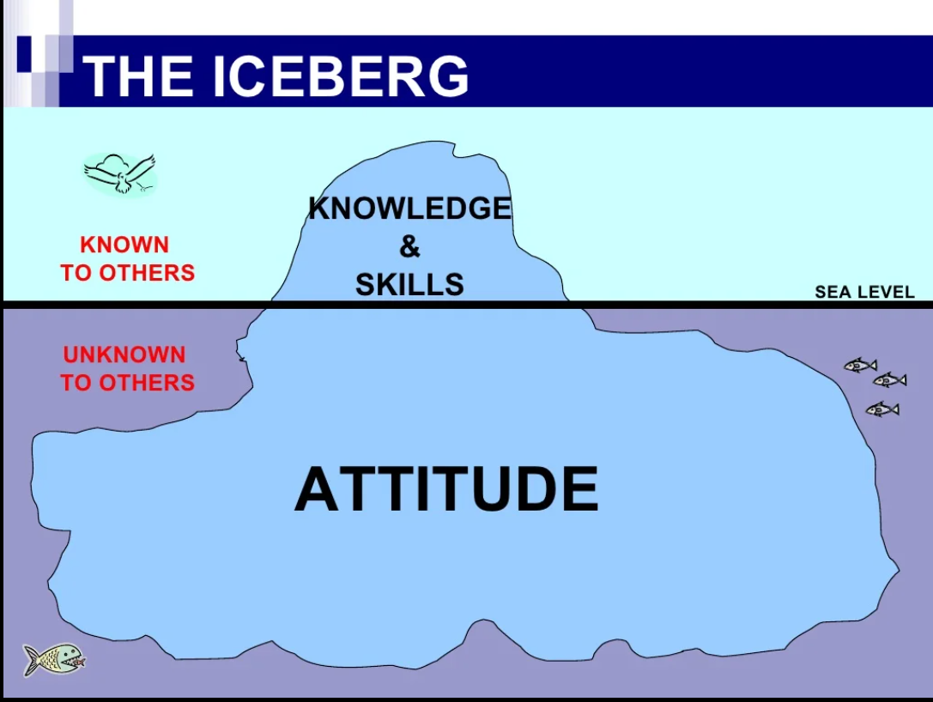

Slide 31
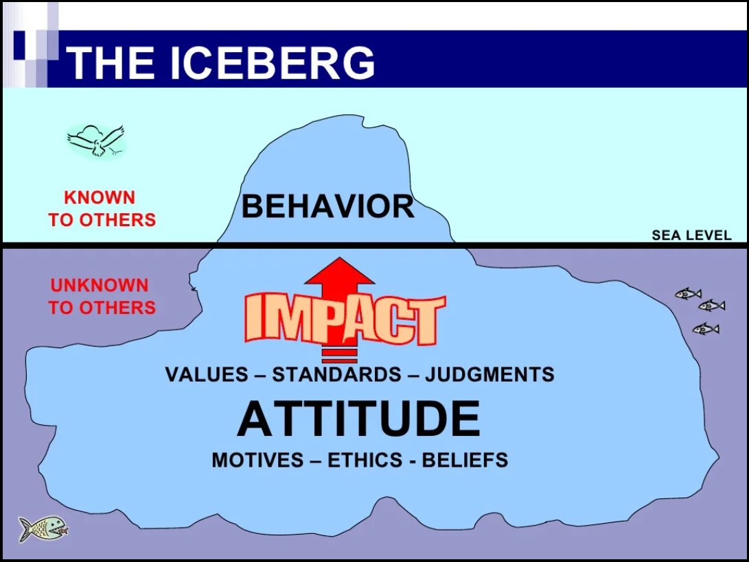

Slide 32
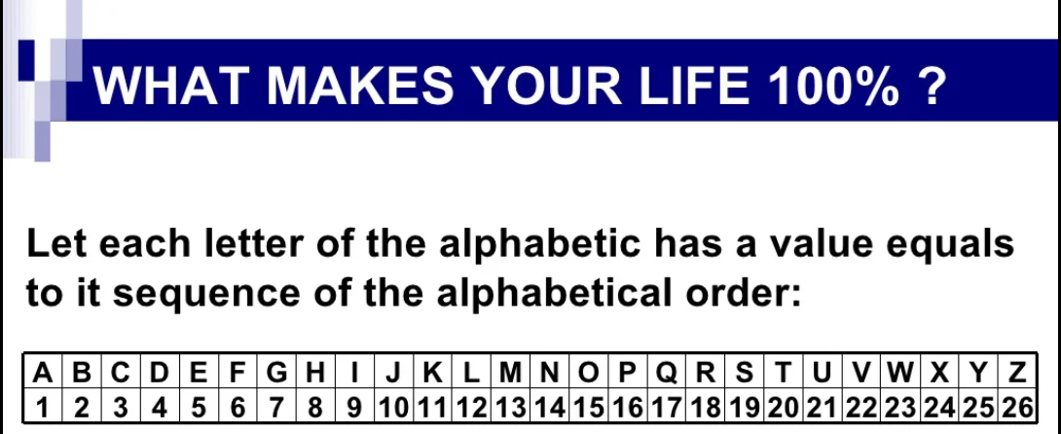

Slide 33
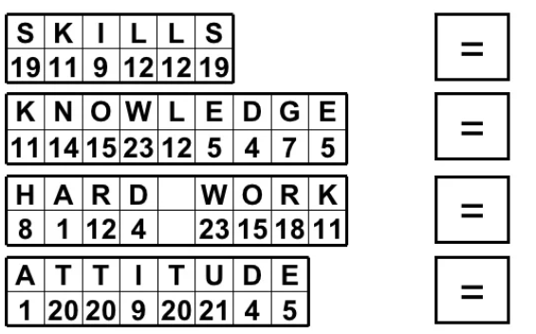

Slide 34
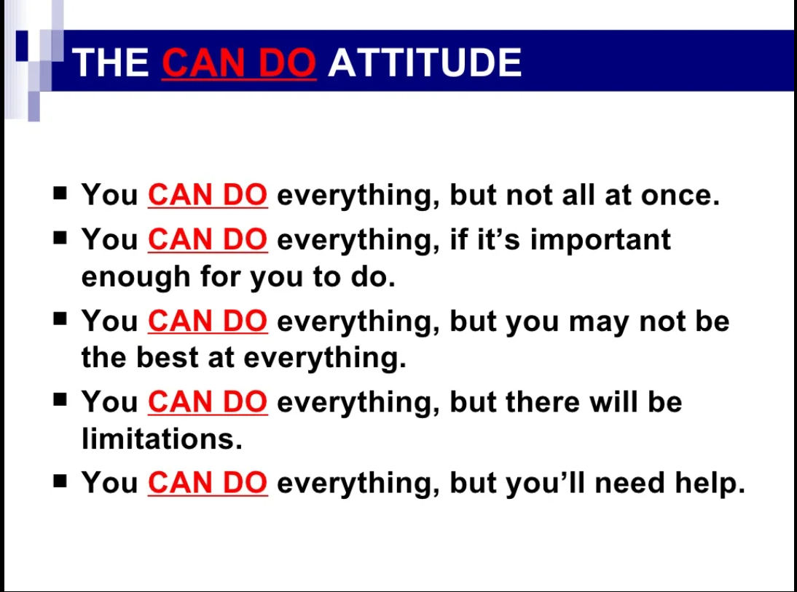

Slide 35
Building a Resume

Slide 36
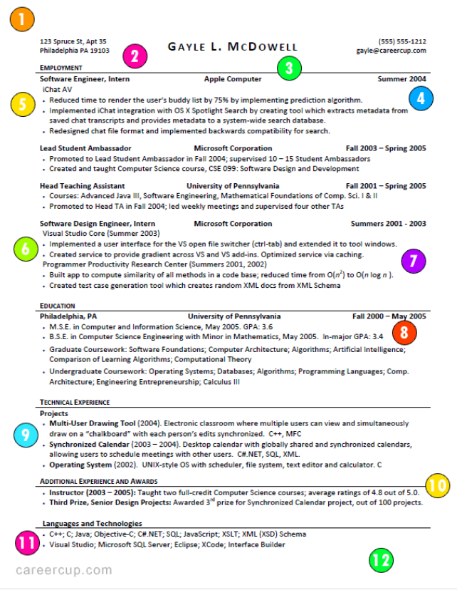

Slide 37
Few websites to your rescue
1. Career cup
https://www.careercup.com/resume
2. Zetty
https://zety.com/
3. Nova
https://novoresume.com/

Slide 38
How to prepare for the interview
and
face the interview(s)

Slide 39
Coding challenge platforms
https://leetcode.com/
https://www.geeksforgeeks.org/
https://www.hackerrank.com/
https://www.hackerearth.com/
https://www.freecodecamp.org/
https://www.codechef.com/

Slide 40
Few websites to your rescue
1. Linkedin
https://linkedin.com/
2. Naukri
https://www.naukri.com/

Slide 41
References and Credits 1. Google 2. YouTube 3. Mahatria AKA T T Rangarajan 4. Gururaj Karjagi 5. Sandeep Maheshwari 6. Puzzles to puzzle you – By Shakuntaladevi

Slide 42
I am reachable here
linkedin.com/in/vinayak-goni
Email: vinayakgbiet@gmail.com
Phone: +91-7795640413

Slide 43


Slide 44
Thanks

